Slide 1

North Carolina Weather & Crops Report (Overview)
March 24, 2011
Drought Management Advisory Council (DMAC) Meeting

Slide 2
North Carolina Weather & Crops Report
We send out to respondents in every county in North Carolina
Mostly consist of Co. extension agents and a few regional agronomists
Respondents answer questions on crop progress, crop conditions, and soil moisture
Respondents also able to give comments on unusual situations or things going on in their respective counties

Slide 3
North Carolina Weather & Crops Report
(Cont’d)
Also get data from State Climate Office
Monthly (December- March)
Weekly (April- November)
The first weekly of this season is April 4th

Slide 4
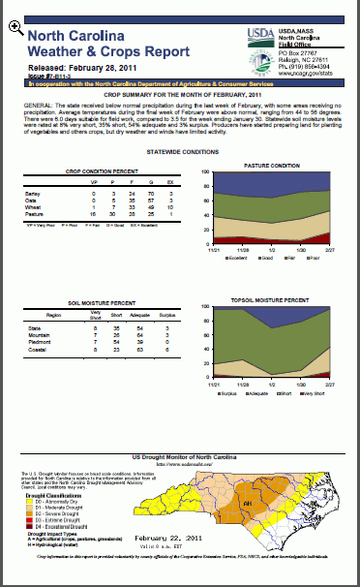
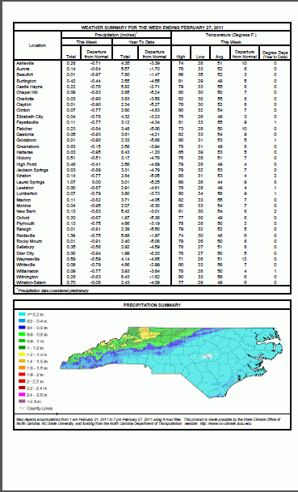

Slide 5
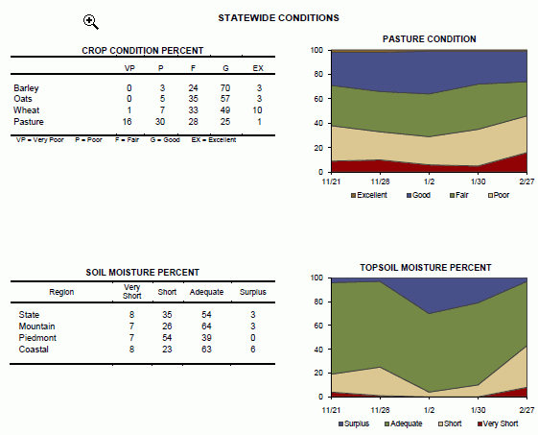

Slide 6
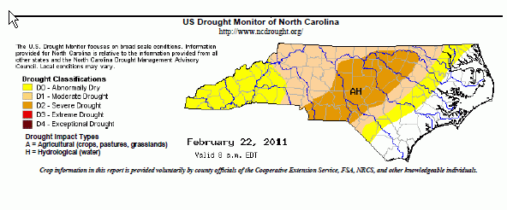

Slide 7
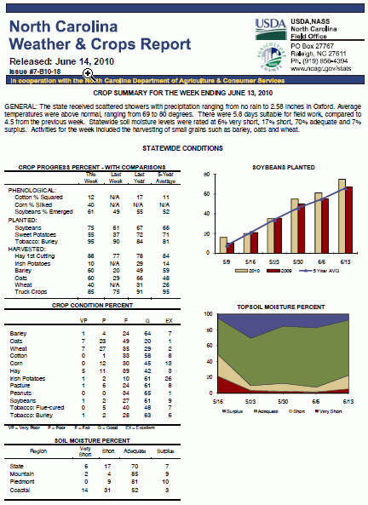

Slide 8
Contact Information
Torey Lawrence
torey_lawrence@nass.usda.gov
(919) 733-6333 x 302
North Carolina Crop Weather:
http://www.ncagr.gov/stats/weather/weather.htm
Other North Carolina Agricultural Statistics:
http://www.ncagr.gov/stats/index.htm

